Slide 1
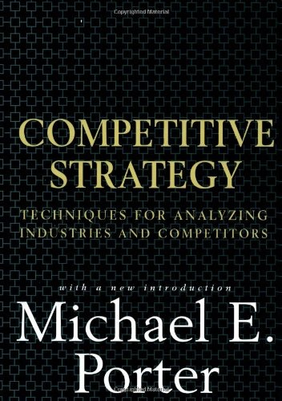
PORTERS 5 FORCES
Developed by Michael Porter
Harvard Business School
PhD Economics
Professor
1985 appointed to President Ronald Reagan's Commission - Industrial Competitiveness
1990's “Strategy guru” on international speaking circuit

Slide 2
Threat of New Entrants
Your business/product is a NEW entrant!
Entry ease / Barriers?
Are there incumbents that will try to BLOCK your entry?
How will they do this?
Geographic factors
New entrant strategy. . . .differentiation!
Routes to Market?
Notes:
Profitable markets that yield high returns will attract new firms. That is why you are seeking to launch this business! This results in many new entrants, which eventually will decrease profitability for all firms in the industry. There is only so much money to be made from your target market, unless you expand the market. So, for the time being, let us accept that the market size will stay as is.

Slide 3
Suppliers & Customers
Bargaining power of customers (buyers)
Buyers Choice
Buyers size/number
Changes cost/frequency
Product/service importance
Volumes, JIT (Just-in-time) scheduling
Bargaining power of suppliers
Brand reputation
Geographical coverage
Product/service level quality
Relationship with other customers
Bidding process & capabilities

Slide 4
Product & Technology Development
Threat of substitute products or services
Alternatives price/quality
Market distribution changes
RFID tags. . .POS software enhancements. . .Drones. . .
Fashions & trends
PLM
Fastfit360
Legislative effects . . .trade agreements . . .regulations

Slide 5
Competitive rivalry
Intensity of competitive rivalry
Number & size of firms . . .NAME 3 for this project
Industry size and trends
Fixed vs. variable costs
Product/services ranges
Differentiation & strategies
SWOT . . . FOR EACH COMPETITOR

